Slide 1

Foundations of Cryptography IND-CCA, malleability, sEUF-CMA, IND-CPA+sEUF-CMA $⇒$ IND-CCA cryptographic hash function
LiangFeng Zhang
zhanglf@shanghaitech.edu.cn

Slide 2












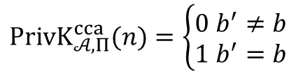
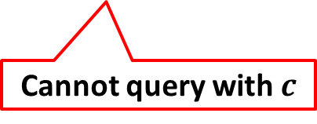
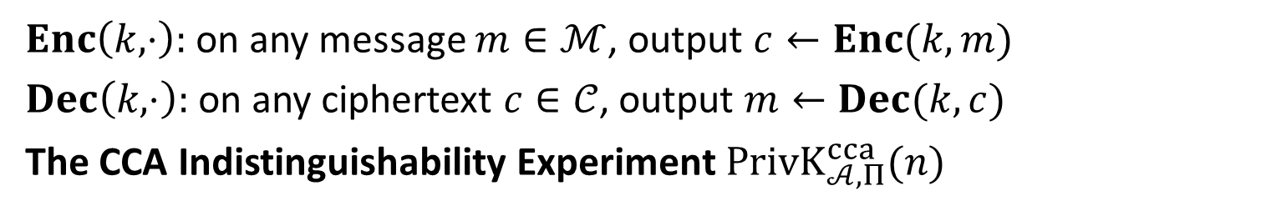


$$\text{Chosen}\text{−}\text{Ciphertext} \text{Attack}$$
$Enc\left(k,⋅\right):$on any message $m∈ℳ$, output $c←Enc(k,m)$
$Dec\left(k,⋅\right):$on any ciphertext $c∈𝒞$, output $m←Dec(k,c)$
The CCA Indistinguishability Experiment $PrivK_{𝒜, Π}^{cca}(n)$
$$k←Gen\left(1^{n}\right)$$
$$oracle access to$$
$$Enc\left(k,⋅\right), Dec(k,⋅)$$
$$m_{0},m_{1}$$
$$\left|m_{0}\right|=|m_{1}|$$
$$Challenger$$
$$b←\{0,1\}$$
$$Adversary 𝒜$$
$$c←Enc(k,m_{b})$$
$$c$$
$$oracle access to$$
$$Enc\left(k,⋅\right), Dec(k,⋅)$$
$$b′$$
$$PrivK_{𝒜, Π}^{cca}(n)=\left\{\begin{aligned}0 b^{′}≠b \\ 1 b^{′}=b\end{aligned}\right.$$
Cannot query with $c$

Slide 3
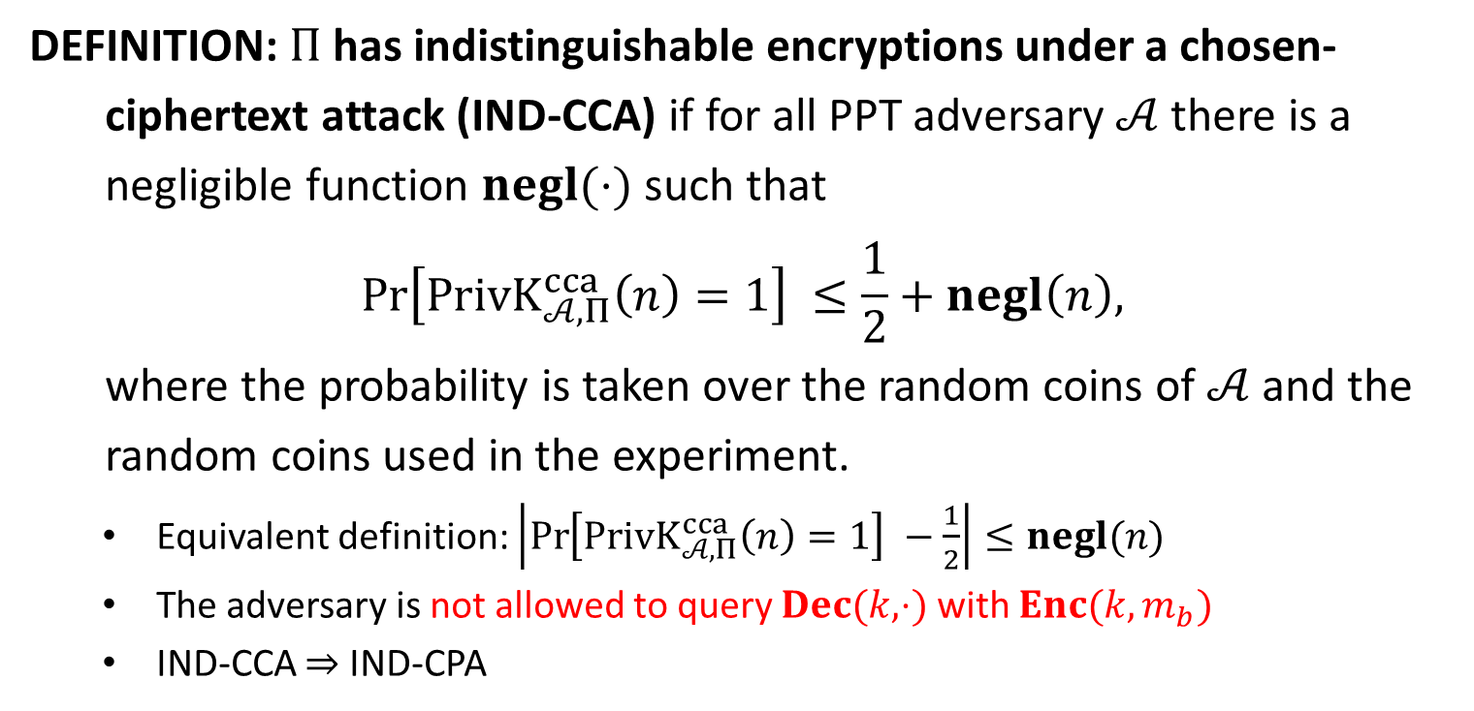
IND-CCA
DEFINITION: $Π$has indistinguishable encryptions under a chosen-
ciphertext attack (IND-CCA) if for all PPT adversary $𝒜$ there is a
negligible function $negl(⋅)$ such that
$$\operatorname{Pr}\left[PrivK_{𝒜, Π}^{cca}\left(n\right)=1\right] ≤\frac{1}{2}+negl\left(n\right),$$
where the probability is taken over the random coins of $𝒜$ and the
random coins used in the experiment.
Equivalent definition: $\left|\operatorname{Pr}\left[PrivK_{𝒜, Π}^{cca}\left(n\right)=1\right] −\frac{1}{2}\right|≤negl(n)$
The adversary is not allowed to query $Dec(k,⋅)$ with $Enc(k,m_{b})$
IND-CCA $⇒$ IND-CPA

Slide 4

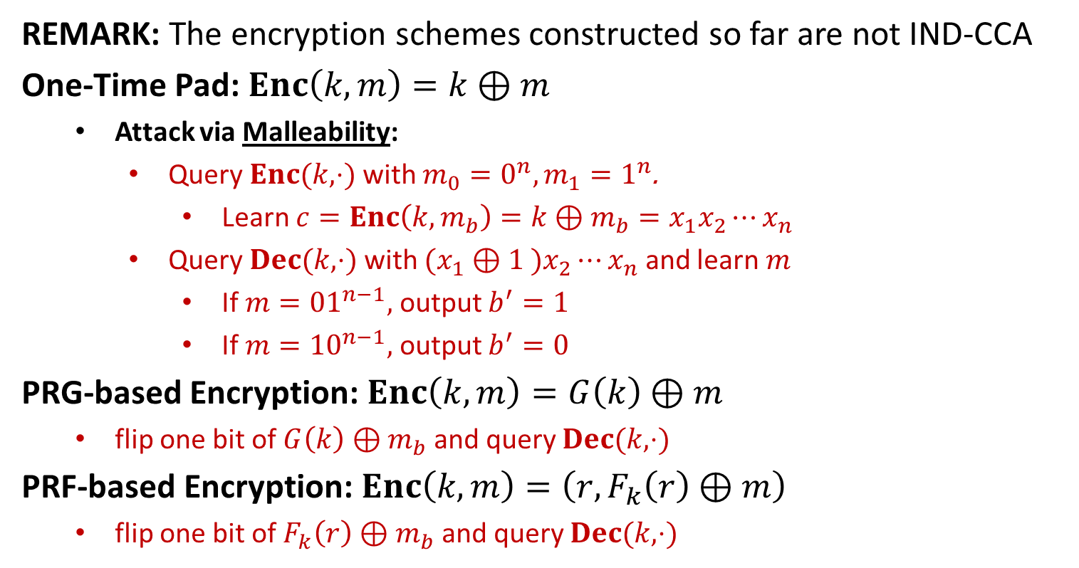







Examples of CCA
REMARK: The encryption schemes constructed so far are not IND-CCA
One-Time Pad: $Enc\left(k,m\right)=k⊕m$
Attack via Malleability:
Query $Enc(k,⋅)$ with $m_{0}=0^{n},m_{1}=1^{n}$.
Learn $c=Enc\left(k,m_{b}\right)=k⊕m_{b}=x_{1}x_{2}⋯x_{n}$
Query $Dec(k,⋅)$ with $(x_{1}⊕1 )x_{2}⋯x_{n}$ and learn $m$
If $m={01}^{n−1},$ output $b^{′}=1$
If $m={10}^{n−1},$ output $b^{′}=0$
PRG-based Encryption: $Enc\left(k,m\right)=G\left(k\right)⊕m$
flip one bit of $G\left(k\right)⊕m_{b}$ and query $Dec(k,⋅)$
PRF-based Encryption: $Enc\left(k,m\right)=\left(r,F_{k}\left(r\right)⊕m\right)$
flip one bit of $F_{k}\left(r\right)⊕m_{b}$ and query $Dec(k,⋅)$
$$m$$
$$Enc$$
$$c$$
$$f′$$
$$f$$
$$m′$$
$$c′$$
$$Dec$$

Slide 5








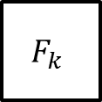





Examples of CCA
OFB: $F$ is a block cipher with block length $n$
$$IV$$
$$F_{k}$$
$$F_{k}$$
$$F_{k}$$
$$m_{1}$$
$$⨁$$
$$m_{2}$$
$$⨁$$
$$m_{3}$$
$$⨁$$
$$IV$$
$$c_{1}$$
$$c_{2}$$
$$c_{3}$$
Attack via Malleability:
Flip one bit of $c_{1}$ and query the decryption oracle

Slide 6









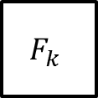



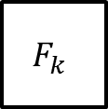


Examples of CCA
CTR: $F$ is a block cipher with block length $n$
$$ctr$$
$$ctr+1$$
$$ctr+2$$
$$ctr+3$$
$$F_{k}$$
$$F_{k}$$
$$F_{k}$$
$$m_{1}$$
$$⨁$$
$$m_{2}$$
$$⨁$$
$$m_{3}$$
$$⨁$$
$$ctr$$
$$c_{1}$$
$$c_{2}$$
$$c_{3}$$
Attack via Malleability:
Flip one bit of $c_{1}$ and query the decryption oracle

Slide 7


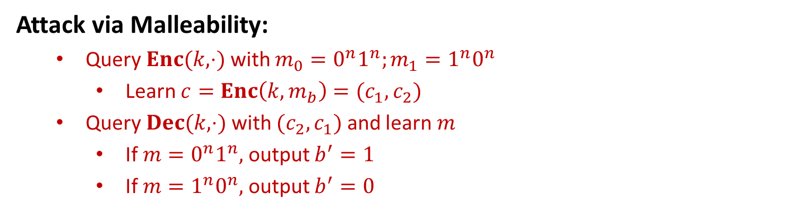






Examples of CCA
ECB: $F$ is a block cipher with block length $n$
$$m_{1}$$
$$m_{2}$$
$$m_{3}$$
$$F_{k}$$
$$F_{k}$$
$$F_{k}$$
$$c_{1}$$
$$c_{2}$$
$$c_{3}$$
Attack via Malleability:
Query $Enc(k,⋅)$ with $m_{0}=0^{n}1^{n};m_{1}=1^{n}0^{n}$
Learn $c=Enc\left(k,m_{b}\right)=(c_{1},c_{2})$
Query $Dec(k,⋅)$ with $(c_{2},c_{1})$ and learn $m$
If $m={0^{n}1}^{n},$ output $b^{′}=1$
If $m={1^{n}0}^{n},$ output $b^{′}=0$

Slide 8




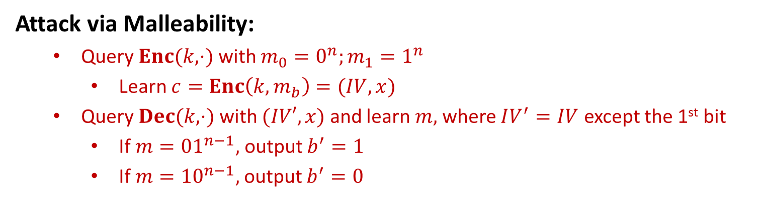



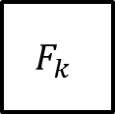





Examples of CCA
CBC: $F$ is a block cipher with block length $n$
$$m_{1}$$
$$m_{2}$$
$$m_{3}$$
$$IV$$
$$⨁$$
$$⨁$$
$$⨁$$
$$F_{k}$$
$$F_{k}$$
$$F_{k}$$
$$IV$$
$$c_{1}$$
$$c_{2}$$
$$c_{3}$$
Attack via Malleability:
Query $Enc(k,⋅)$ with $m_{0}=0^{n};m_{1}=1^{n}$
Learn $c=Enc\left(k,m_{b}\right)=(IV,x)$
Query $Dec(k,⋅)$ with $(IV′,x)$ and learn $m,$ where $IV^{′}=IV$ except the 1st bit
If $m={01}^{n−1},$ output $b^{′}=1$
If $m={10}^{n−1},$ output $b^{′}=0$

Slide 10


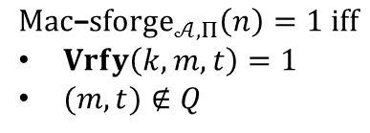





sEUF-CMA
The Strong Message Authentication Experiment: $Mac$-$sforge_{𝒜,Π}(n)$
$$k←Gen\left(1^{n}\right)$$
$$orace access to$$
$$Mac(k,⋅)$$
$$Challenger$$
$$Adversary 𝒜$$
$$(m,t)$$
$$Mac\text{−}sforge_{𝒜,Π}\left(n\right)=1 iff$$
$Vrfy\left(k,m,t\right)=1$
$(m,t)∉Q$
$Q:$ the set of (message, tag) pairs queried by $𝒜$

Slide 11
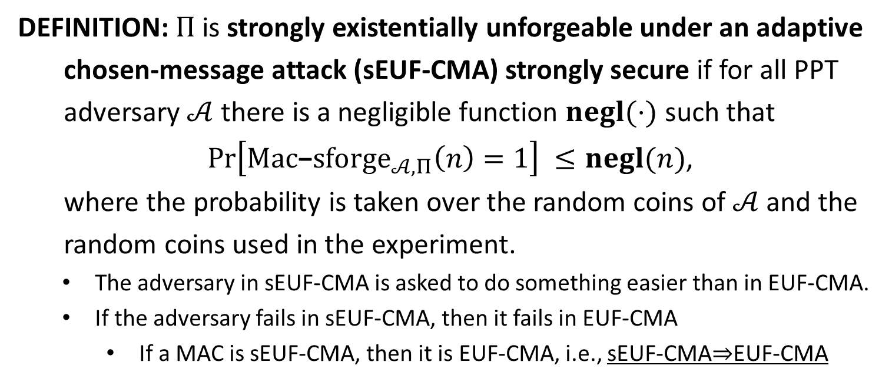
sEUF-CMA
DEFINITION: $Π$is strongly existentially unforgeable under an adaptive
chosen-message attack (sEUF-CMA) strongly secure if for all PPT
adversary $𝒜$ there is a negligible function $negl(⋅)$ such that
$\operatorname{Pr}\left[Mac\text{−}sforge_{𝒜,Π}\left(n\right)=1\right] ≤negl(n)$,
where the probability is taken over the random coins of $𝒜$ and the
random coins used in the experiment.
The adversary in sEUF-CMA is asked to do something easier than in EUF-CMA.
If the adversary fails in sEUF-CMA, then it fails in EUF-CMA
If a MAC is sEUF-CMA, then it is EUF-CMA, i.e., sEUF-CMA$⇒$EUF-CMA

Slide 12
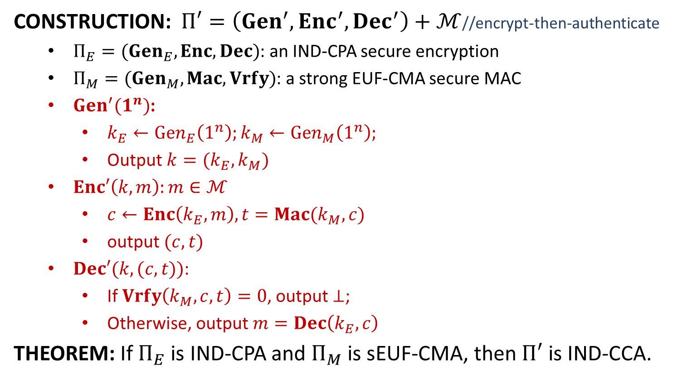
IND-CCA from IND-CPA and sEUF-CMA
CONSTRUCTION: $Π′=\left(Gen^{′}, Enc^{′}, Dec^{′}\right)+ℳ$//encrypt-then-authenticate
$Π_{E}=(Gen_{E}, Enc, Dec)$: an IND-CPA secure encryption
$Π_{M}=(Gen_{M}, Mac, Vrfy)$: a strong EUF-CMA secure MAC
$Gen^{′}(1^{n})$:
$k_{E}←Gen_{E}\left(1^{n}\right);k_{M}←Gen_{M}\left(1^{n}\right);$
Output $k=(k_{E},k_{M})$
$Enc′\left(k,m\right):m∈ℳ$
$c←Enc\left(k_{E},m\right), t=Mac(k_{M},c)$
output $(c,t)$
$Dec′(k,(c,t))$:
If $Vrfy\left(k_{M}, c,t\right)=0$, output $⊥$;
Otherwise, output $m=Dec\left(k_{E},c\right)$
THEOREM: If $Π_{E}$ is IND-CPA and $Π_{M}$ is sEUF-CMA, then $Π′$ is IND-CCA.

Slide 13
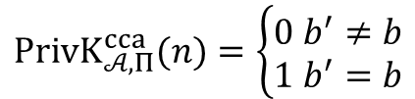




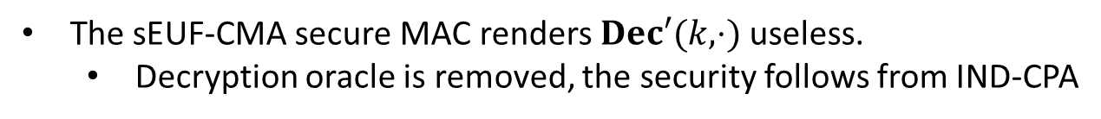









Idea of Security Proof
$$k←Gen′\left(1^{n}\right)$$
$$oracle access to$$
$$Enc′\left(k,⋅\right), Dec′(k,⋅)$$
$$m_{0},m_{1}$$
$$\left|m_{0}\right|=|m_{1}|$$
$$Challenger$$
$$b←\{0,1\}$$
$$Adversary 𝒜$$
$$c←Enc′(k,m_{b})$$
$$c$$
$$oracle access to$$
$$Enc′\left(k,⋅\right), Dec′(k,⋅)$$
$$b′$$
$$PrivK_{𝒜, Π}^{cca}(n)=\left\{\begin{aligned}0 b^{′}≠b \\ 1 b^{′}=b\end{aligned}\right.$$
The sEUF-CMA secure MAC renders $Dec′(k,⋅)$ useless.
Decryption oracle is removed, the security follows from IND-CPA

Slide 15
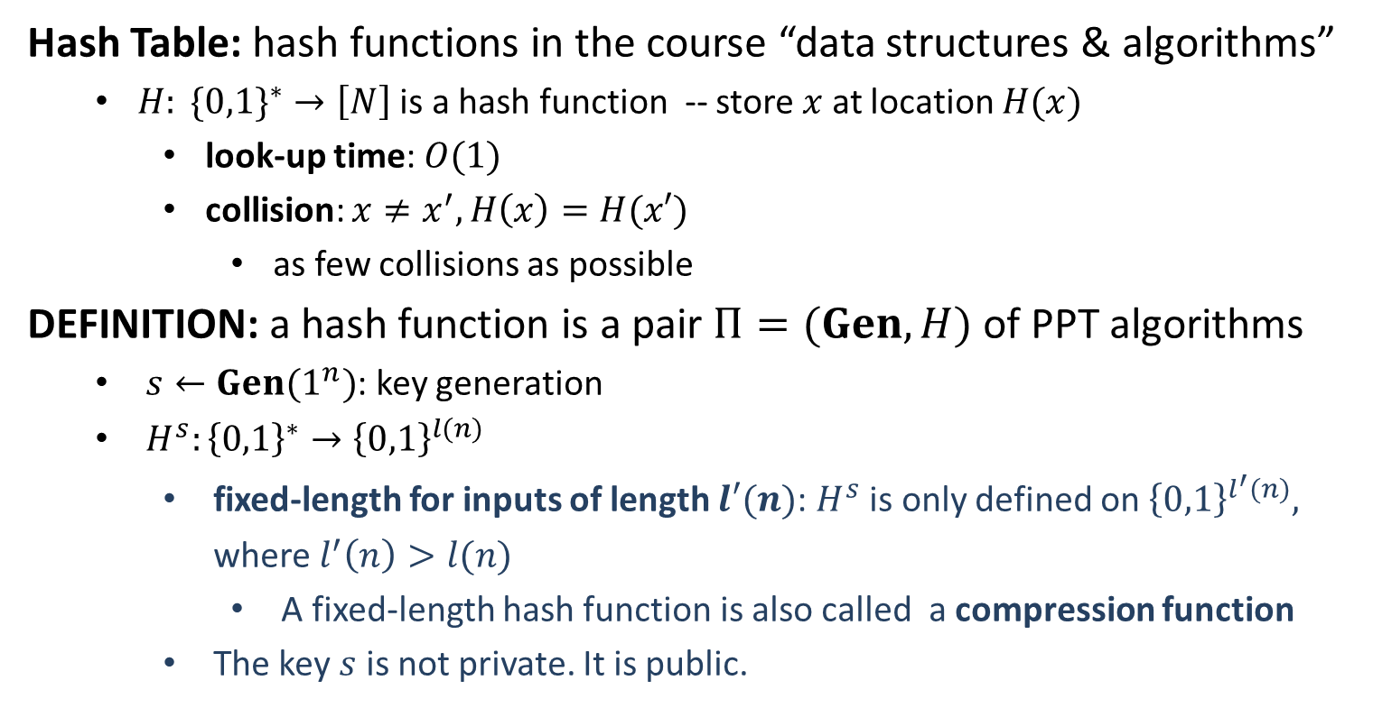
(Cryptographic) Hash Function
Hash Table: hash functions in the course “data structures & algorithms”
$H: \{0,1\}^{∗}→\left[N\right]$ is a hash function -- store $x$ at location $H(x)$
look-up time: $O(1)$
collision: $x≠x^{′}, H\left(x\right)=H(x′)$
as few collisions as possible
DEFINITION: a hash function is a pair $Π=(Gen, H)$ of PPT algorithms
$s←Gen(1^{n})$: key generation
$H^{s}:{\left\{0,1\right\}}^{∗}→{\left\{0,1\right\}}^{l(n)}$
fixed-length for inputs of length $l′(n)$: $H^{s}$ is only defined on ${\left\{0,1\right\}}^{l^{′}(n)},$ where $l^{′}\left(n\right)>l(n)$
A fixed-length hash function is also called a compression function
The key $s$ is not private. It is public.

